Slide 1

DISSERTATION WORK REVIEW - I
DEPARTMENT OF COMPUTER SCIENCE AND ENGINEERING
JAWAHARLAL NEHRU TECHNOLOGICAL UNIVERSITY HYDERABAD
UNIVERSITY COLLEGE OF ENGINEERING, SCIENCE AND TECHNOLOGY, HYDERABAD
A STANDARDISED COMPOSITE TRUST SCORE FOR EVALUATING EXPLAINABLE AI (XAI) TECHNIQUES:A CROSS –DOMAIN EMPIRICAL VALIDATION
PRESENTED BY:
N.SROHANA
22011P0510
B.TECH-IDP
V YEAR - I SEMESTER
CSE , JNTUH UCEH
GUIDE:
DR. R SRIDEVI
BE(CSE),M.TECH,PHD
PROFESSOR IN CSE & COORDINATOR,
CENTRE OF EXCELLENCE IN CYBER SECURITY,
JNTUH

Slide 2
TABLE OF CONTENTS
ABSTRACT
INTRODUCTION
EXISTING SYSTEM
PROBLEM STATEMENT
PROPOSED ARCHITECTURE
PROPOSED METHODOLOGY
REFERENCES

Slide 3
ABSTRACT
OBJECTIVE:
To design and empirically validate a standardized, quantitative Trust Score (TS) that measures the effectiveness of XAI techniques (Control ,LIME, SHAP, and counterfactual explanations) in improving calibrated human trust in machine learning model predictions, compared to a no-explanation baseline, across multiple application domains.
KEY FEATURES:
Composite metric: integrates calibrated trust accuracy, decision accuracy, response time, self-reported trust (Trust-in-Automation scale), and explanation satisfaction into a single reproducible Trust Score.
Controlled within-subjects study: 4 explanation conditions across 2 domains using fixed black-box classifiers.
Empirically derived weights: component weights for the composite score are derived via factor analysis on pilot data, not assigned arbitrarily.
Statistical validation: reliability (Cronbach's alpha), convergent and discriminant validity against existing trust scales, and mixed-effects ANOVA across conditions and domains.
Goal: a standardized, reusable instrument enabling objective, reproducible comparison of XAI techniques across future studies.

Slide 4
INTRODUCTION
ML models are increasingly deployed in high-stakes domains such as finance and healthcare, where predictions must be accompanied by human-interpretable justification.
Explainable AI (XAI) techniques — LIME, SHAP, and counterfactual explanations — are widely used to justify black-box model predictions to end users.
Systematic reviews show substantial technical progress in explanation methods themselves, but no universally accepted framework exists for measuring whether these techniques actually increase human trust.
Existing studies rely on inconsistent, ad hoc trust measures — self-reported surveys, task accuracy, or response time — used in isolation and evaluated independently across studies.
This fragmentation limits reproducibility and prevents objective, like-for-like comparison of XAI techniques across studies and domains.
This dissertation addresses that gap directly by proposing and validating a composite Trust Score that integrates multiple existing trust-related signals into one standardized, reproducible metric.

Slide 5
EXISTING SYSTEMS
(Is Trust Correlated With Explainability in AI? A Meta-Analysis — Atf & Lewis, IEEE TTS, 2026)
Self-reported trust surveys: e.g., the Trust-in-Automation scale (Jian et al., 2000), used across many XAI studies to gauge user trust after seeing explanations.
Behavioural proxies: decision accuracy and response time are commonly logged as indirect, objective signals of trust and reliance.
Explanation-specific measures: instruments such as Hoffman et al.'s (2018) Explanation Satisfaction Scale evaluate a single explanation instance.
CHALLENGES:
No standardized composite exists: self-report, accuracy, response time, and satisfaction are used in isolation, never combined into one validated metric.
Incomparability across studies: single-dimension, ad hoc measures cannot be meaningfully compared across different studies or domains.
Untested cross-domain generalizability: no existing composite has been validated across genuinely different application domains, such as finance and healthcare, at once.

Slide 6
PROBLEM STATEMENT
To design and empirically validate a standardized, quantitative Trust Score that integrates calibrated trust accuracy, decision accuracy, response time, self-reported trust, and explanation satisfaction into a single reproducible metric — and to evaluate its effectiveness and cross-domain generalizability for assessing XAI techniques.

Slide 7
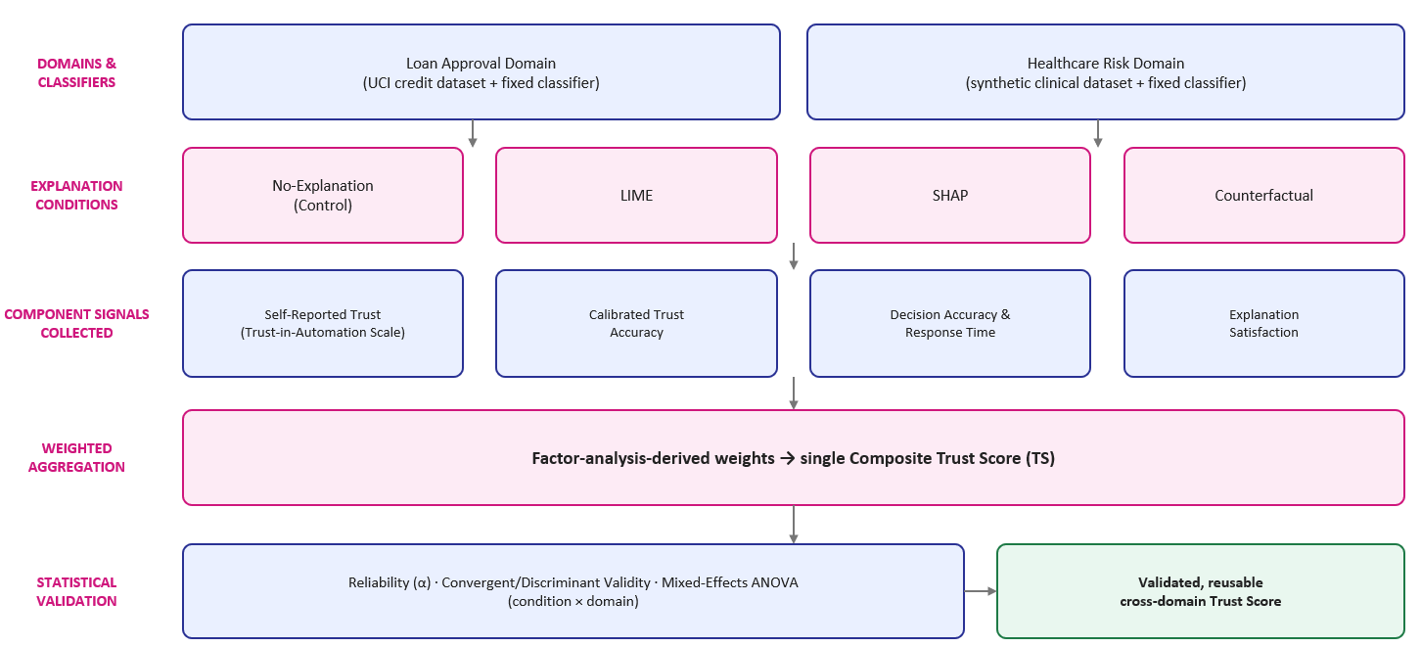
PROPOSED ARCHITECTURE

Slide 8
PROPOSED METHODOLOGY
Select components: conduct a literature-grounded selection of Trust Score components from existing XAI trust-measurement studies.
Design and pilot: design the composite Trust Score instrument and pilot it; derive component weights empirically via factor analysis on pilot data.
Develop materials: fix black-box classifiers and generate matched explanation artifacts — LIME feature-weight charts, SHAP force plots, counterfactual statements — for both domains.
Run the study: recruit the target sample and run a controlled, within-subjects study with Latin-square-randomized explanation order.
Collect data: record self-reported trust, decision accuracy, response time, and explanation satisfaction for every task instance.
Validate statistically: test reliability, validity (convergent/discriminant), and run mixed-effects ANOVA across explanation conditions and domains.
Benchmark: compare the composite Trust Score's discriminative power against single-dimension trust measures used in prior work.

Slide 9
REFERENCES
[1] Wiratsin, T., & Ragkhitwetsagul, C. — Effectiveness of XAI Techniques for Improving Human Trust in ML Models: A Systematic Literature Review (2025).
[2] Atf, Z., & Lewis, P. R. — Is Trust Correlated With Explainability in AI? A Meta-Analysis — IEEE Transactions on Technology and Society, Vol. 7, No. 1, pp. 70–77, March 2026. doi: 10.1109/TTS.2025.3558448
[3] Jian, J.-Y., Bisantz, A. M., & Drury, C. G. — Foundations for an Empirically Determined Scale of Trust in Automated Systems — International Journal of Cognitive Ergonomics, 4(1), 53–71, 2000. doi: 10.1207/S15327566IJCE0401_04
[4] Hoffman, R. R., Mueller, S. T., Klein, G., & Litman, J. — Metrics for Explainable AI: Challenges and Prospects — arXiv:1812.04608, 2018.

Slide 10
THANK YOU

